Slide 1

Data science PROJECT on subscription service
By: FANIYI ANUOLUWAPO MARGARET
Ladies Data Science Training April. 2023
GITHUB REPO LINK : https://github.com/Anumarg/SubscriptionService.git

Slide 2
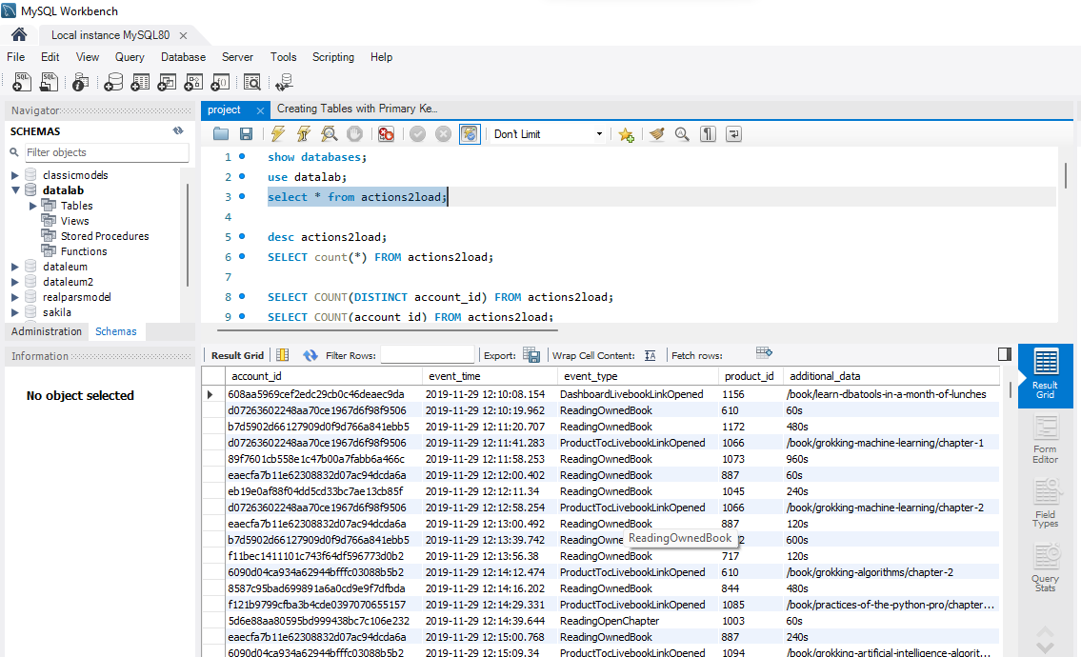
Load the Data into MYSQL Database

Slide 3
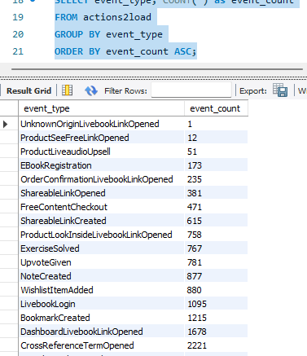
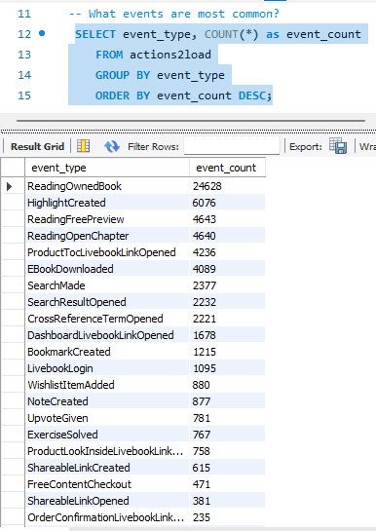
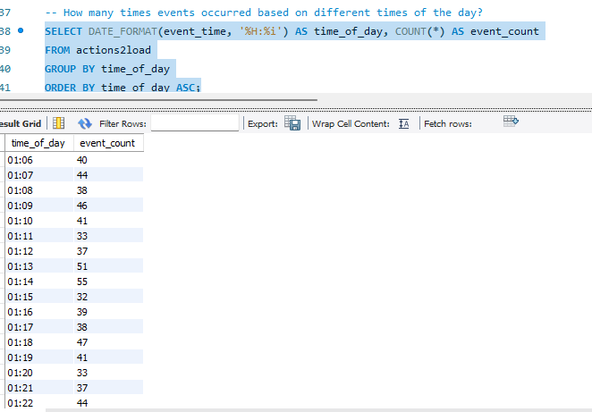
Answer SQL business Questions

Slide 4
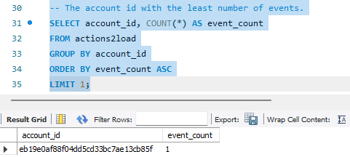
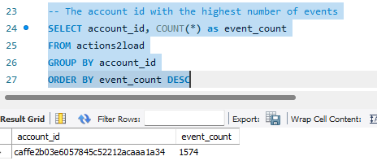
Answer SQL business Questions

Slide 5
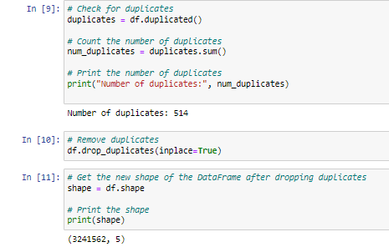
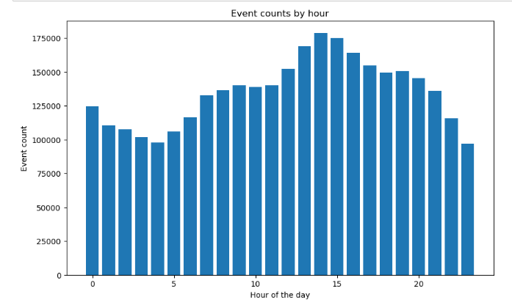
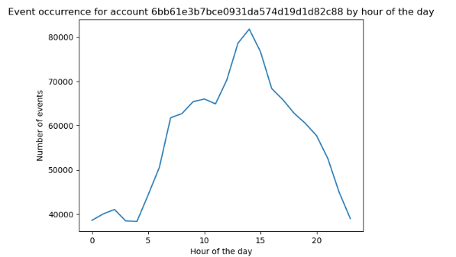
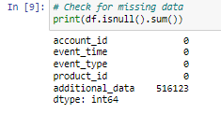
Quality assessment of data and identification of patterns
The dataset named actions2load consists of 3,242,076 rows and 5 columns.
Events occur unequally during various periods of the day. Discover a visualization for this particular slide.
Examine a presentation showcasing the analysis of an account ID, revealing insights into the user's service utilization at different times throughout the day.
The final column, referred to as the additional column, contains some missing data.

Slide 6
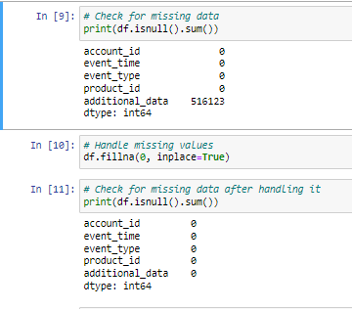
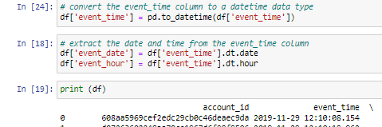
FIXING BAD DATA
I eliminated the missing data in the additional data column.
514 duplicate values were eliminated from the dataset.
Following these operations, the data set consisted of 3,241,562 rows and 5 columns.
To address the issue, I converted the timestamps in the "event time" feature to the datetime data type. Additionally, I extracted the date and time information from the event-time column.

Slide 7
